Slide 1
INJURY REMEDIES OF COMPOSITAE FAMILY
Arnica montana
Bellis perenis
Calendula officinalis
Cineraria maritima
Erigeron canadensis
Achiller millefolium
Prepared by,
Dr. C. R. Krishna Kumari Amma
Prof. and Head, Dept. of Materia Medica

Slide 2
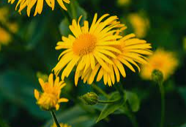
ARNICA MONTANA

Slide 3
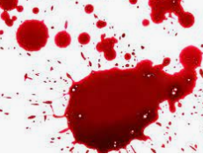
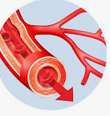
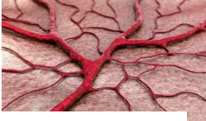
Common Name: Leopards Bane, Wolf’s bane
Prover : Dr. Hahnemann
Family ; Compositae
Sphere of action
Blood Blood vessels Capillaries

Slide 4
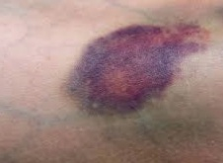
Injuries
Traumatic / Mechanical injuries
Bruises

Slide 5
It is especially suited to cases when any injury, After traumatic injuries, overuse of any organ, strains.
Sore, lame, bruised feeling.

Slide 6
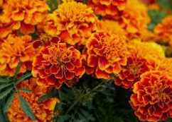
CALENDULA OFFICINALIS
Common Name: Marigold
Family ; Compositae

Slide 7
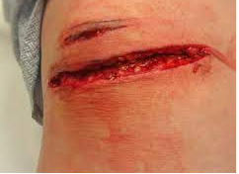
INJURIES
Open &
Lacerated wound

Slide 8
A most remarkable healing agent, applied locally. Useful for open wounds, parts that will not heal, ulcers, etc. Promotes healthy granulations and rapid healing by first intention.
Pain is excessive and out of all proportion to injury.

Slide 9
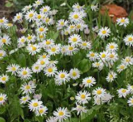
BELLIS PERENNIS
Common Name : Daisy. Bruise wort
Family : Compositae

Slide 10
This remedy is useful for injuries to the trunk and deeper tissues—as from falls, car accidents, surgery, etc. —especially if a feeling of stiffness or coldness develops in the injured area. If Arnica has been given for an injury—especially a strain or bruise—but has not had much effect, Bellis perennis may be helpful.

Slide 11
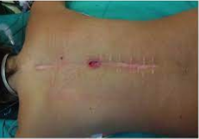
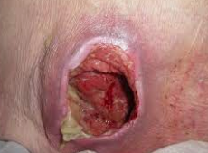
Deeper tissues
After major surgical works

Slide 12
CINERARIA MARITIMA
Has some reputation in the cure of cataract and corneal opacities. Is used externally, by instilling into the eye one drop four or five times a day. This must be kept up for several months. Most effective in traumatic cases.

Slide 13
LEDUM PAL
For punctured wounds, produced by sharp-pointed instruments or bites particularly if the wounded parts are cold, this is the remedy. Tetanus with twitching of muscles near wound.

Slide 15
This relieves bruises from blunt objects, especially where the skin is thin (around the eyes, fingers and toes), as well as pain and bruising from pointed objects.

Slide 16
OTHER REMEDIES

Slide 17
Ruta graveolens
This remedy relieves strained ligaments and tendons.

Slide 18
Symphytum
It stimulates the growth of epithelium on ulcerated surfaces.
It may be administered internally in the treatment of gastric and duodenal injuries , tendons and the periosteum. Acts on joints generally.

Slide 19
This remedy is best known for its healing effect on broken bones, and is also good for bone-bruises. It is valuable if blunt injury occurs to the eyeball (from a rock, a stick, a flying object, etc.) Any injury to the eye or eyeball

Slide 20
great use in wounds penetrating to perineum and bones, and in non-union of fractures; irritable stump after amputation, irritable bone at point of fracture. Psoas abscess. Pricking pain and soreness of periosteum.

Slide 21
HYPERICUM
The great remedy for injuries to nerves, especially of fingers, toes and nails.
Crushed fingers, especially tips.
Excessive painfulness is a guiding symptom to its use.
Punctured wounds.
Relieves pain after operations.

Slide 22
Hypericum Perforatum is a homeopathic medicine for a head injury that is followed by headaches. Soreness of eyes with a headache, a sensation of being lifted up high in the air are the main symptoms. Hypericum is also indicated for treating a fracture of the skull, and for open wounds with weakness due to blood loss.

Slide 23
Staphysagria
:It is a very useful remedy for cuts, incisions, lacerations and stab wounds that are slow to heal. It helps to treat lacerations and extremely painful wounds.

Slide 24
Phosphorus
It is indicated for wounds which bleed profusely, heals and then break open and bleed again. Profuse bleeding with bright red blood.

Slide 25
Calcarea phosphorica
It is useful in treating useful bruises, slow-healing fractures and injuries involving bones. Pain and soreness of the muscles.

